Slide 1
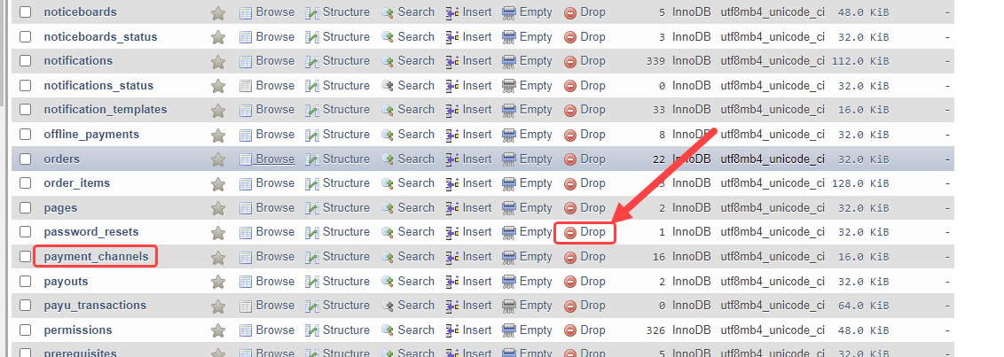
Go to Phpmyadmin and select your LMS the database.
Drop the “payment_channels” Table.

Slide 2
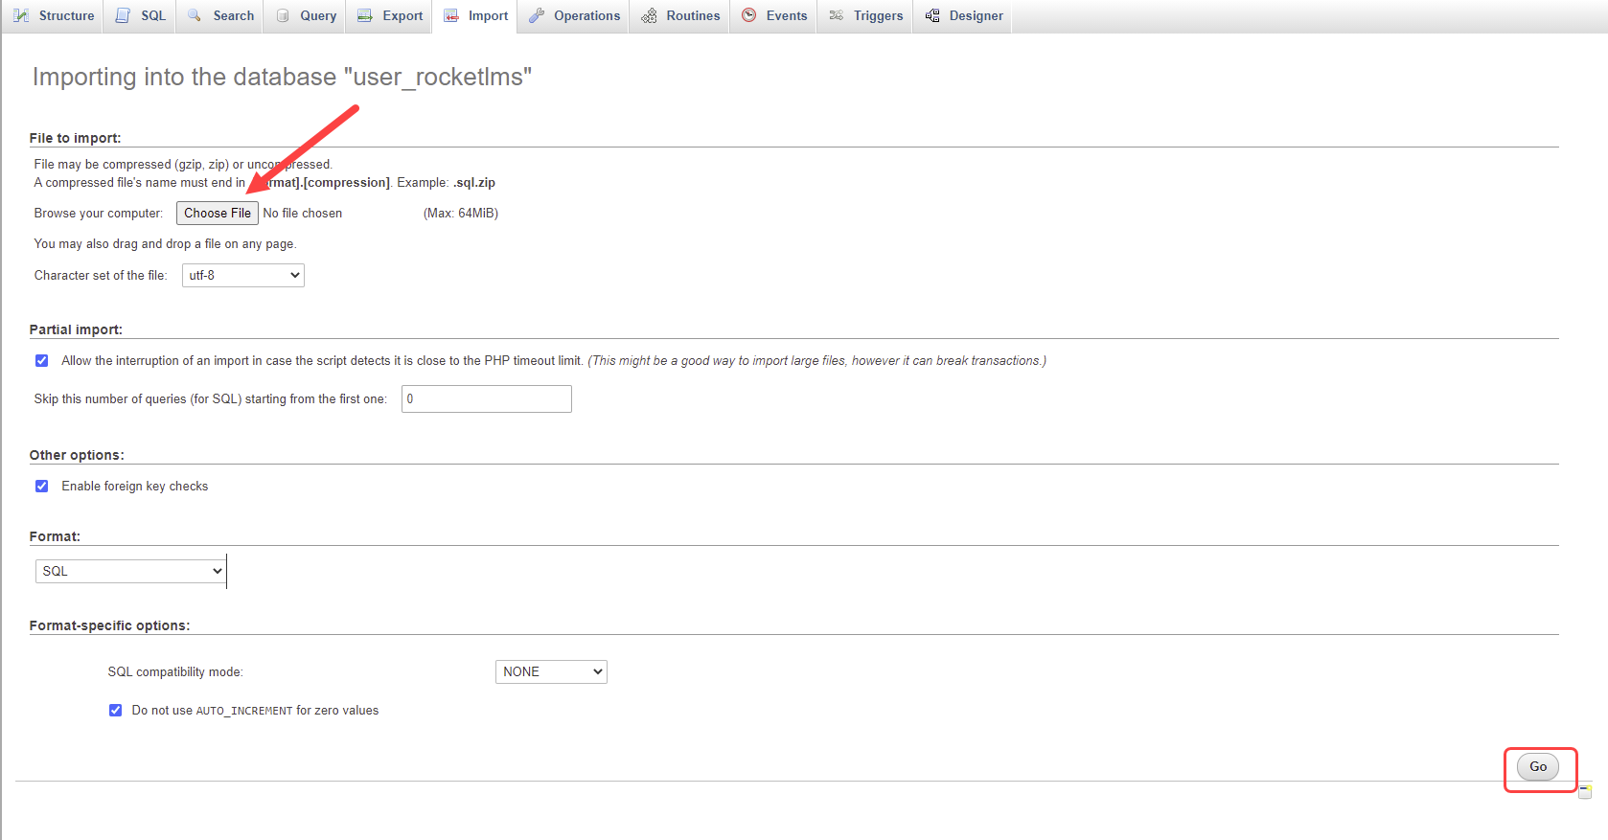
Navigate to the “Import” tab.
Import “Payment_gateways.sql” file to your database

